Slide 1








2018
2017
Build an immutable application infrastructure with Nano Server, PowerShell DSC, and the
release pipeline
Containers! Where is my PowerShell?
Ravikanth Chaganti
Jan Egil Ring & Øyvind Kallstad

Slide 2
Agenda
Management of containers using PowerShell
Using PowerShell inside containers
Windows & Linux containers side-by-side
Notes:
Gothas
New PowerShell module for Docker
Docker build
Windows containers running Nano
Linux containers
Image2Docker
PowerShell Universal Dashboard running on both Linux and Windows

Slide 3
Demo

Slide 4
Discussion point
PSDockerTools – new community-based module
Go or no-go?
Are there any value in creating a «proper» Docker module for PowerShell, or will most people use the native Docker CLI (docker.exe) anyway?

Slide 5
Summary
PowerShell is great for managing containers
ConvertFrom-Json is your friend
PowerShell can be the glue for integrations
PowerShell can be used inside containers
“ Business as usual“ – can be used like we are used to
With PowerShell Core, it is also possible to leverage PowerShell inside Linux and Nano Server containers
Notes:
PowerShell inside containers, exception: GUI-based cmdlets such as Out-GridView won`t work since containers is headless.

Slide 6
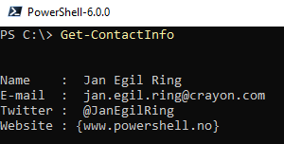
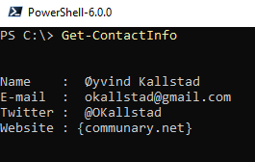
about_Author
Notes:
function Get-ContactInfo {
[pscustomobject] @{
Name = ' Jan Egil Ring '
'E-mail ' = ' jan.egil.ring@crayon.com'
Twitter = ' @JanEgilRing '
Website = @('www.powershell.no’)
} | Format-List
}
function Get-ContactInfo {
[pscustomobject] @{
Name = ‘ Øyvind Kallstad'
'E-mail ' = ‘ okallstad@gmail.com'
Twitter = ‘ @OKallstad'
Website = @(‘communary.net’)
} | Format-List
}
Get-ContactInfo

Slide 7
Next Steps
Now: 15 min break
Grab a coffee
Stay here to enjoy next presentation
Change track and switch to another room
Ask me questions or meet me in a breakout session room afterwards

Slide 8
Questions?

Slide 9
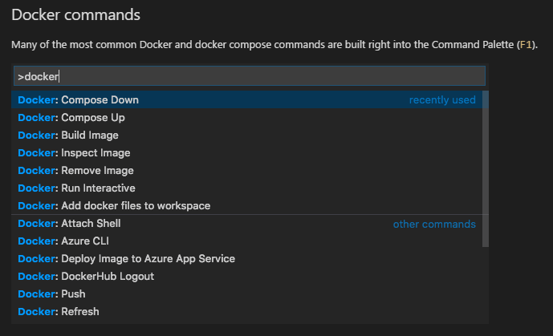
Bonus tip: VS Code Extension for Docker

Slide 10
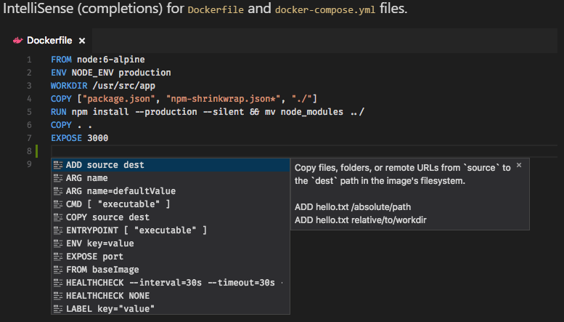
VS Code Extension for Docker

